Slide 1

What Cameroon's development partners in-country could do, to help mitigate drivers of the country's Anglophone crisis
10 February 2021

Slide 2
Background: conflict vulnerability of officially multilingual States
In officially multilingual countries, conflict between language systems as they compete for use, is a distinct possibility. Language policy can be contentious, and trigger social and political tensions (South Africa, Belgium, Canada)
Language conflict tends to manifest itself in specific domains of public life, such as language of access to, and used in State/public services, language of instruction in schools, and languages used in judicial/legal systems and proceedings.
Where a country harbours official language diversity, Development Partners (DPs) are well-advised to factor same into their analytics of possible sources of exclusion, perceptions of injustice, and vulnerability to slide into conflict
Where the preponderance of use of official languages is territorially-concentrated, DPs should be alert to centrifugal tendencies (away-from centre pressures) for higher devolution, autonomy, and even separatist tendencies.

Slide 3
Background: conflict vulnerability of officially multilingual States
DPs have a key role in assisting such States to craft policies which “accommodate” and provide equal opportunities to users of both/all official language, as a core conflict mitigation, management, and prevention of recurrence strategy.
When DPs are sensitive to such official language (OL) diversity, while working in specific sectors such as Education Sector support, Justice Sector Support, Devolution and Subnational Governance, and State Language policies, they are making a critical investment in conflict prevention in the country.
Important in policy dialogue with GoC to remind that Cameroon is not the only country facing these dynamics around multilingualism and conflict (and it has to manage them with a developing country’s resources). Other countries’ comparative experiences have yielded entire domains of technical expertise, which GoC with support from DPs can avail itself of, and deploy in the conflict-prone sectors :

Slide 4
Four (4) conflict-mitigation, management strategies from comparative experiences of officially multilingual States, relevant to Cameroon:
  Language Policy and Planning in officially multilingual States
  Language-in-Education Policy for officially multilingual States
  Bijuralism, pluri-juralism, and coexistence of more than one major legal tradition
  Asymmetrical devolution arrangements (including for Unitary States)
  NEXT :
  What is the situation (practice, law, policy) in Cameroon and why prone to conflict ?
  What is the way forward; concrete entry points to turn the tide?

Slide 5
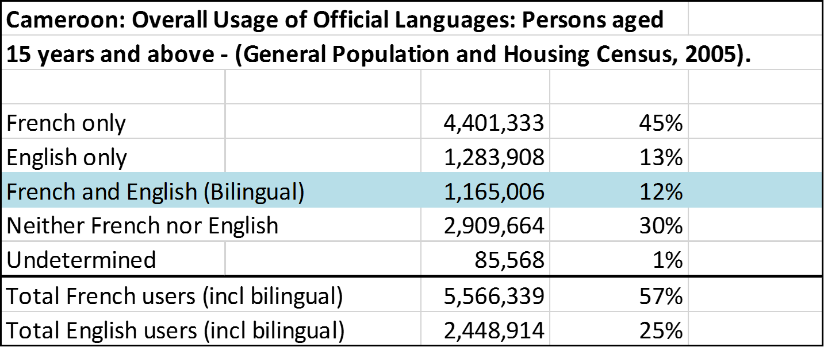
OFFICIAL LANGUAGES: LANGUAGE POLICY AND PLANNING
Caveat : Bilingualism, notably English use may have increased in 15 years since 2005 (due to French OL1 Millennials'’ uptake of English as language of instruction)

Slide 6
Territorial & Regional Preponderance in Use of Official Languages

Slide 7
Language use in citizens’ daily access to State services, by public officials/State staff, and in official transactions, procedures, other public domains
Cameroon had no law regulating same, granting entitlement to public interactions in one or other official language for 58 years (1961-reunification to 2019); only a Constitutional requirement of equality of official languages (since 1996) and lower administrative circulars “reminding” State employees/services of need to be bilingual.
No formal bilingualism test or requirement as pre-requisite for graduation from the multiple Grandes Ecoles which train/produce Cameroon’s civil service higher echelons (Civil/Territorial Administrators, Tax, Finance, Customs, Magistracy) or other key corps with citizen interactions (such as Police, Gendarmerie); or as requirement for deployment to the field.
To date, Cameroon has no single State Policy or Strategy document on Languages (official, and other), which assigns Languages use, valorising functions, and planning for acquisition, retention, preservation, revitalization of languages.
Per linguists, language specialists, lack of regulation of official languages results in “survival of the fittest” with language dominance in public/private spheres based on linguistic demographics, differential prestige, usefulness, hierarchy between the OLs : higher number of users of French vs. English, hence language “hierarchies” (Ayafor, Simo Bobda, Abongdia)

Slide 8
Ambivalence on citizens’ rights to be rendered State/official services in OL of choice:
Dec. 2019 Official Language Law
Legal Effect: Users’ right to communicate in the OL of their choice (S.15) unmatched by a corresponding duty / obligation of the public/State official to render service in the user’s OL of choice. Duty of public officials is to render service in “any” of the official languages (S. 13.2)

Slide 9
Crisis began in 2016 with foyers of tension in the Education and Justice/Legal sectors between the associated official language systems. But Cameroon’s linguists and specialists in language policy and planning showed high prescience, as early as a decade before the crisis, that tensions were possible and in the offing, due to lack of language regulation. (Anchimbe, Simo Bobda, Echu).
Notable example: competing, non-complementary, non-nationally harmonious identities among “new English” learners as language of instruction, inter-generational switchers to the English schooling system.
Respondent learners / parents who adopted/acquired English through language of instruction switching considered their identities as “different” from Cameroon’s historical English users (Anglophones). Theirs as a more superior, or extroverted (global appeal) brand of English.
Reinforcement of existing hierarchized stereotypes between official language users / communities. (Anchimbe). Extension of the “Bamenda” epithet in social, cosmopolitan slang.

Slide 10
Recommended Policy Solution: Language Policy and Planning for an officially multilingual State, with multiple endogenous languages of regional, local reach (Chumbow, 2012)
Official Languages : national reach
Vehicular languages : regional/cross
regional reach
Local Languages : local reach/use

Slide 11
Recommended Entry Point Activities
Support linguists, language policy and planning specialists, as a professional discipline, to conduct consultations and articulate, in line with best practices, standards, and norms of the discipline, a substantive Language Policy vision for Cameroon, as a technical study, proposal. (Cameroon Society of Linguistics, Language Policy specialists). Rationale: to fill the substantive Language Policy void.
Support a scoping study on appropriate institutionalization of the Language Policy and Planning function in Cameroon. Cameroon does not have a “Central Language Authority in the form of a Language Institute, Language Centre, Language Academy, or Language Board” which would serve as its institutional nerve-centre for language policy, planning, and management. Reason: to fill the Language planning institutional void.
Support a survey to improve metrics (measurement) of differential impact upon citizens of past/ existing language policies, based on the Official Language they primarily use. Go beyond languages’ use by public bodies to their weight in broader economy and society. Include impact on social mobility, career advancement (public, private sectors), wage/earnings differentials. Rationale: better quantification, metrics of extent of exclusion / dissatisfaction felt by English OL 1 users (minority official language).

Slide 12
EDUCATION SECTOR: LANGUAGE-IN-EDUCATION PLANNING & POLICY

Slide 13
Legal Framework
Loi N° 98/004 du 14 avril 1998 d'orientation de l'éducation au Cameroun:
Article 15. (1) Le système éducatif est organisé en deux sous-systèmes, l'un anglophone, l'autre francophone, par lesquels est réaffirmée l'option nationale du biculturalisme. (2) Les sous-systèmes éducatifs sus évoqués coexistent en conservant chacun sa spécificité dans les méthodes d'évaluation et les certifications.
Decree No. 2011-45 of 08 March 2011 to Organize the University of Bamenda:
Article 1 (a). There shall be established a body corporate conceived in the Anglo-Saxon tradition by the name of The University of Bamenda.

Slide 14
Inter-educational system differences grounded in history
Francophone sub-system (predominant in 8 Regions)
Modelled on the French public (State) school, grounded in the Lois Jules Ferry of 1881-1882 in France, providing for obligatory, free universal primary education, and especially laicity of public schooling (laïcité de l’enseignement public).
Proactive pre-independence State provision of education, with only relative participation of missionary societies.
Anglophone sub-system (predominant in 2 Regions)
Grounded and developed by Missionary Societies (Baptist, Protestant, Catholic) as the dominant purveyors of education, under British indirect rule (not the State) for its overseas mandate and trust territories. Modelled on English boarding medium - school. Preponderant role of religious authorities and moral (vs. civic) instruction.
Under-spending on education as Native/Local Authorities expected to fund lower educational tiers.
Key Source: Georges & Christiane Courade: Historical study on Education in Anglophone Cameroon

Slide 15
Historical resistance to education system(s) fusion
Educational sub-systems have in past 60 years (since 1961-reunification) largely functioned in parallel, resisting attempts at fusion. EG: 1961 Federal Constitution made education a “federal” area of jurisdiction, but in practice, West Cameroon Government continued to run English sub-system separately.
Historical resistance to merger of two educational sub-systems into one common stream. 1960s: experiment at a common trunk, fused secondary track (Bilingual Grammar Schools) dropped. Dual exams mandatory for English OL1 students, not for French OL 1 students. 1983: another attempt at fusion / reform dropped. 1998: Education Framework Law confirmed option for 2 sub-systems, each preserving its specificities.
Principal concerns against fusion: Absorption / assimilation (phagocytage) of 1 system by the other (usually of English by French due to minority demographic). Pedagogic burden, weight of two concurrent languages of instruction in schools, whether at primary or secondary education levels.
Current low-intensity, pilot efforts at “bilingual” education streams, e.g., Programme d’Enseignement Bilingue Spéciale, limited to few public secondary schools. BUT significant adherence to non-State regulated dual/combined language of instruction (50-50) in lower primary years for pupils. Private sector schools driven, in urban areas. Often preparation for full immersion/switching of language-in-education track, for French OL 1 learners.

Slide 16
Territorial & Regional Preponderance (Enrolment) in education sub-systems
Source : Cameroon Ministry of Secondary Education, Annual Statistical Yearbook, 2013-2014

Slide 17
Historical cross-educational system performance, outcomes, internal efficiency issues
Source: Document de Stratégie Sectorielle de l’Education, 2005

Slide 18
Analysis ….
Caveat : Despite the higher rate of “retention” and “completion” in primary schooling in the Anglophone sub-system,
the data tended to show a significant rate of non-pursuance of (failure to transition into) Secondary education

Slide 19
Historical Class Repetition Rates : Primary & Secondary Education (2002-2003)
Source: Document de Stratégie Sectorielle de l’Education, 2005

Slide 20
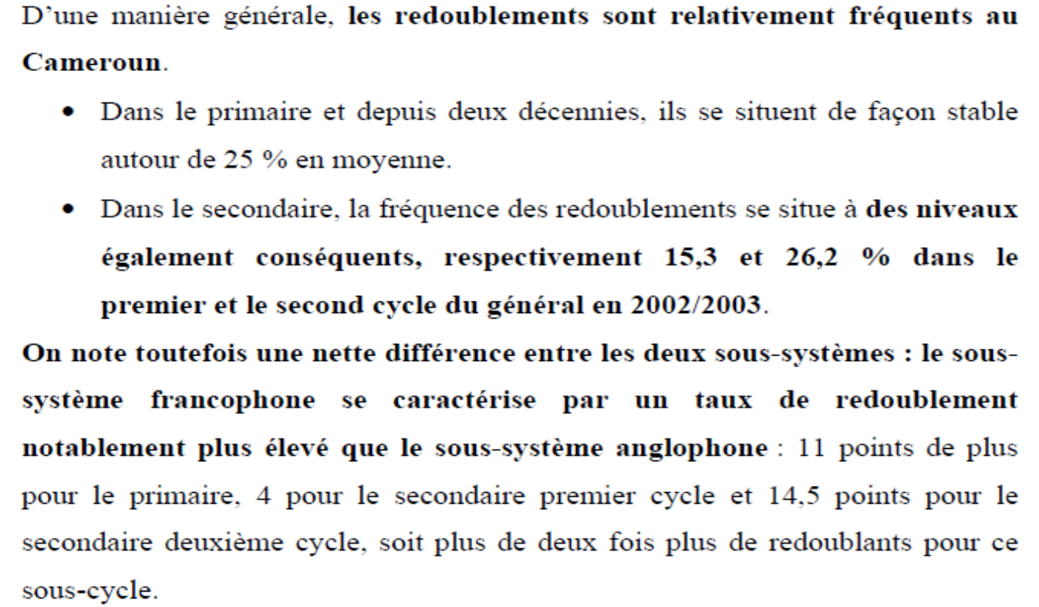

Analysis …
Source : Document de Stratégie Sectorielle de l’Education, 2005

Slide 21
Mid-Point Assessment: Class Repeater rates in Secondary Education (2009-2010)
Source: Rapport d’Analyse des Données des la Carte Scolaire du MINESEC, Année Scolaire 2009 - 2010

Slide 22
Analysis and perceptions …
Caveat: End of secondary examinations pass rates (BEPC/CAP/BAC, and GCE O & A Levels, however, generally tend to show relatively similar pass rates between the Anglophone and Francophone sub-systems
Source: Rapport d’Analyse des Données des la Carte Scolaire du MINESEC, Année Scolaire 2009 - 2010

Slide 23
Contemporary : Class Promotion & Repetition Rates - Secondary Education (2014-15)
Source: Analysis Report of Statistical Data of MINESEC, Academic Year 2014 - 2015

Slide 24
Source: Analysis Report of Statistical Data of MINESEC, Academic Year 2014 - 2015

Slide 25
Millennials & Globalization Trend (since 2000) : Language-in-Education shifts
Increased cross-enrolment into English educational subsystem by French OL1 families
Against the above backdrop, enter the Millennials (2000), the advent of globalization, and perceptible shifts in the perception of English as a language in Cameroon marked by the following trends:
Changes in the status, value, prestige of English, no longer as the demographically, functionally lesser-used OL within Cameroon, but as the language vector of opportunity for academic, professional, technological advancement, especially to benefit from global interactions outside Cameroon. Hence dualism of “status” of English as a language (lower within Cameroon, higher outside Cameroon: Abongdia).
Perceptible trend of parental choice to cross-enroll learners from earliest educational tiers (nursery, primary) from the parents’ OL 1 (French) to their OL 2 (English) as the language medium-of-instruction in school. Cameroon’s variant of “immersion” or “submersion” language learning, often dual-language in primary, and then full English language-in-education in secondary.
Largely French OL1 parental/learner choice, private sector provisioning as boost (50-50, or full English primary learning), State un-regulated as access/switching across systems fully permissible. Enrolment in historical English medium (primary/secondary) schools reaches 30, 50% of “new English” learners in large cities (Yaoundé, Douala) + multiple English boarding schools across NW, SW regions where are concentrated. (See: Echu/PNEU study, Mforteh, Anchimbe, Kuchah Kuchah).

Slide 26
Millennials’ (continued)
Trend starts on positive footing: learners have no apparent problems with uptake of English as language, and content acquisition in English; parents/learners satisfied with what they perceive as a new value-set (discipline, conscientiousness in studies, good extra-curricular behaviour) and seen as positive example compared to peers/siblings in French school sub-system (Echu et al). However, not without its own challenges.
Close study by Cameroonian linguists, language planners, language-in-education specialists show that different markers of “identity formation” are emerging around the acquisition/use of English through learning in that medium in school. When asked, “new English” learners see themselves as users of global English, and as “different” from the Cameroonian (historical) Anglophone predominantly in/from NW, SW regions. Despite learning in its environment / resources, perception of Cameroonian English as “inferior” prevail. New English is “extroverted” (globalisation), not directed at better interaction within Cameroon.
Arrival in significant demographic numbers of new learners, in English language of instruction schools ushers signs of competition for scarce learning resources (school spaces) in English, especially where perceived as hard-earned spots for historical minority (English) language education, such as higher education (1964 – 1993, no English language University). 2006: Uni Buea riots (fatal) over medical school admissions as State homologates to require some Francophone admittees. Uneasy relations between official language communities at UB.
Historical Anglophone parents/alumni compete for offspring’s admission spaces in elite/top-performing English boarding schools in NW-SW, with “new English” learners.

Slide 27
Long range demographic trends in English/French sub-system enrolment : NURSERY
Sub-system / Academic Year | 2003-2004 | 2013-2014 | 2015-2016
English Nursery | 22% | 34% | 36%
French Nursery | 78% | 66% | 64%

Slide 28
NURSERY by sub-system. 2015-2016 (so prior to any NW-SW crisis education displacement)

Slide 29
Long range demographic trends in English/French sub-system enrolment : PRIMARY
Sub-system / Academic Year | 2003-2004 | 2013-2014 | 2015-2016 | 2017-2018
English Primary | 22% | 22% | 22% | 18%
French Primary | 78% | 78% | 78% | 82%
NOTES
Overall, a constant trend -- not showing demographic increase in English primary school enrolment over 20-year period, which the shifts in language of instruction (new English learners) would have suggested.
Total numbers who attend Nursery school (where 36% in English sub-system) is only a fraction (13%) of total numbers who attend Primary.
However, unclear how the count is done of primary learners’ sub-system and medium of instruction (English or French) since State’s data captures EITHER/OR, whereas an increasingly large number of primary learners are enrolled in dual language medium of instruction primary schools, involving a 50-50 language diet, with election of principal sub-system closer to end of primary exams.
2017-2018 drop attributable to NW-SW crisis peak periods of de-schooling, hence drop in overall English primary enrolment.
Sources: Education Sector Strategic Plan 2003-2004, MINEDUB Analytical Reports on School Map Data.

Slide 30
Long range demographic trends in English/French sub-system enrolment : SECONDARY (Grammar)
Sub-system / Academic Year | 1990-1991 | 2009-2010 | 2013-2014 | 2014-2015
English Secondary | 17% | 23.28% | 25.2% | 25.59%
French Secondary | 83% | 76.72% | 74.8% | 74.41%
Secondary Enrolment – Academic Year 2014-2015 (number of students)
Total | French 2ndary | English 2ndary | 8.5 % English 2ndary Net Gain
1,648,060 | 1,226,321 | 421,739 | 140,085
NOTES
Over the 25-year period, an 8.5 % points gain by the English secondary sub-system over its French counterpart. In 2014-2015 academic year numbers, that net gain equals 140,085 students. This amounts to one-third of all students in Anglophone secondary. That’s the number of “new” unplanned English language-of-instruction learners in secondary.
If only a further 10% of existing French sub-system students (122,632 students) shifted language of instruction to the English sub-system, that “net gain” amount, i.e., additional, unplanned learners seeking English secondary education would rise to 262,717 students, and they would constitute one-half of the entire English subsystem (262,717/544,371 = 48.2%).
Sources : MINEDUC/MINEDUB Analyses of School Map Data

Slide 31
Conclusion – Recommendation : Need for Language-in-Education,
Language-of-instruction planning, demand forecasting, and supply provisioning
Our Core hypotheses:
Given historical demographic patterns in wider population, reflected in school sub-system enrolment (around 20% English, 80% French), significant shifts and switching between language of instruction systems, especially from the majority (French) to minority (English) system, create important dynamics.
At the margins, net gain in demand for the English sub-system (8.5% increase observed over 25 years, at expense of French sub-system) creates increased pressure on supply of English language-of-instruction schooling, reflected in competition for learning resources (school spaces, teachers, boarding school dormitories) in the English sub-system. That 8.5 % increase amounts to one-third of all Anglophone secondary learners.
Due to existing demographic weighting of the school systems’ population, if only a further small percentage (10%, or 122,632 students) of French system learners further shift to the English system, they will constitute close to 50% of English system’s overall student enrolment, hence strain that sub-system’s supply-side resources significantly.
Hence, even “marginal”, unregulated shifts in historically Francophone enrolment should be monitored, planned for, as they can have substantial demand/supply impacts on the smaller English sub-system.

Slide 32
Recommended Policy Solution : Language-in-Education Planning
Language-in-Education policy and planning:
Strategic choices made by States, and/or their sub-national units when so empowered, to determine the language in which schooling or instruction is delivered through the formal school system.
Language-in-education policies : intrinsically linked to, and derive from overall State Language policy and planning, since the process of formal school instruction, and the language of its delivery is critical to the acquisition and retention of languages in a State. (Chumbow, 2012; UNESCO).
Particularly sensitive issue in officially multilingual countries, with potential for social/political contestation; known to be conflict-prone (South Africa: language of instruction in higher education; Belgium: language of education disputes French/Flemish; Canada: English education in Quebec; Cameroon: antecedents with attempted systems’ fusion).
Language of education forecasting = critical, anticipating society and education market-driven trends in demand for education sub-systems, in order to anticipate supply: State provisioning or incentives to meet the said demand.

Slide 33
Recommended Entry Point Activities: Education
1) Recall Section 15(2) – Framework Law on Education (1998). Two sub-systems “co-exist” with each retaining its specificities in evaluation methods and certification. Section 3(2), Special Status provisions of General Code on Regions & Local Councils (2019): “The special status shall also entail respect for the peculiarity of the Anglophone education system”.
Support Education sector specialists, led by Language-in-Education expertise, to articulate a consensual model and standards for education sub-systems’ specificity preservation in Cameroon. Notably : (a) who is entitled to be involved at national policy level in definition of the sub-system’s methods, and (b) in supervision, teaching, dispensation of education/instruction in each language at field, school level (can OL2 trained teacher dispense mainstream subjects in OL1?)
2) Support a learning quality review, and a language access mitigation program/policy in bilingual Universities, where instruction is delivered indistinctly in either OL. Existing studies show weak acquisition due to lecturer/student language-of-instruction dissonance. Access mitigation could include subsidized pre-enrolment language proficiency courses, production of learning notes/materials in Lecturers’ OL2.
3) Support a specialist assessment of dual language-in-education programs at nursery/primary levels, including 50-50, and cross-OL, immersion learning (pupils/students enrolled in different language of instruction from home-use languages), including as to learning acquisition, subsequent retention of both OLs, and factors affecting identity-formation and use of the OLs acquired (including extroversion incentives, globalization factors)

Slide 34
Recommended Entry Point Activities: Education
4) Support a forecasting study on Language-in-Education demand among parents and learners in Cameroon, in order to improve accurate anticipation of future demand for schools, teachers, and learning resources in the English/French sub-systems at primary and secondary levels. Include geographic (by region, urban/rural) and socio-demographic (income group) trends, to fine-tune the predictive tools as to where language-of-instruction shifts in demand are occurring, in order to adjust (provision/incentivize) supply.
5) Support a forecasting study for higher/tertiary education language-in-education demand, in order to anticipate likely future needs and pressures on University/higher education supply in both languages. Upstream demand trends at lower tiers in the educational system (primary-secondary) forebode higher downstream (tertiary) where the student/learner mass will eventually land. May require assessment of tertiary learning supply in both languages (given demographically smaller provisioning in English: UB, UBda), and hence competition especially in STEM/Medicine/Business fields.
6) Support 2 Special Status regions’ eventual functions on English education sub-system policies (different from their education sector roles devolved on parity with other 8 Regions). SS Regions, per S. 327, General Code on Regions/Local Councils shall “participate in the formulation of national public policies relating to the Anglophone education sub-system”. Possibilities include an Education Policy Resource Centre for each, strengthening the respective Regional Commissioners in charge of education.

Slide 35
JUSTICE SECTOR : Bijuralism, Pluri-juralism, Coexistence of Legal Traditions
Cameroon retains 2 separate legal traditions (modes, concept of practicing law), Romano-Germanic and Common Law, albeit without reference to them in formal judicial organization (2006 Judicial Organization Law). Rather, Constitution keeps them applicable (through continued application of “Federated States” pre-1972 laws, which are basis for Civil/Common Law principles’ applicability, “until repealed by new national laws”. Unstable nature of the 2 legal traditions as frame of reference. Supreme Court CL Section (2017 Law) only handles matters not otherwise legislated upon/superseded by legislation.
Unitary State’s corollary was unification of all national laws: achieved in some areas (criminal, criminal procedure, labour, aspects of personal status, business laws) but not in others (contract, tort/delict, succession, civil procedure). Role of Judges in adjudication, rules of legal interpretation, legal training remain different and based on Civil/CL influences, in 8 vs. 2 Regions.
Albeit with increasing Cameroonian law content and supranational treaty, community law (OHADA/CIMA/CEMAC), legal training is conducted with predominant bias (lens) of either Civil, or Common Law techniques, and rarely both (Uni. Dschang exception). English private law / Droit Privé Francophone. Learning of principles/techniques across legal traditions is not mandatory, but elective in University training, but is learnt (Magistrates/Lawyers) “on the job” where deployed, and legal professionals are nationally “mobile” across the 8 vs 2 regions (legal traditions spheres of influence).

Slide 36
Legal Professions’ Statistics: Civil vs Common Law Bias/Training
As at end of 2016, main legal professions’ demographics as below. Caveat: 1200 more lawyers have added on since and English Magistrates increased through 50/year extra English bias/slant Magistrates trained at ENAM Common Law Section since 2017, first graduating batch deployed late 2020. (Source: MINJUSTICE)
Lawyers at the Bar
Civil Law/Francophone | Common Law/Anglophone | Total
1390 (67%) | 696 (33%) | 2086
Magistrates
Civil Law/Francophone | Common Law/Anglophone | Total
1265 (85.3%) | 227 (14.7%) | 1542
Francophone/Civil Law Magistrates in NW-SW at crisis’ onset (2016)
Northwest | Southwest | Total
60/129 (46%) | 57/151 (38%) | 117/280 (41.7%)

Slide 37
Recommended Policy Solution – Bijuralism, Mixed Legal Systems
Bijuralism: accommodation of more than one major legal tradition within a legal system. Efforts to ensure that national laws, legal texts, and procedures, are rendered and applied in a manner that ensures users of each legal tradition find in them, a reflection of the concepts, usages, and terminologies familiar to the said legal tradition – while having the same legal effects nationwide.
Core tenets :
Support the articulation, preparation of an overarching bijuralism policy, which spans from legal
education / training, to legislative drafting, and rules of judicial interpretation of legal texts
2) Support specific capacity development in legislative bijuralism, which consists in techniques of legal and legislative text drafting, which consider the desired effect of the legislator’s intent in both legal traditions and official language systems, including where legal concepts are not readily transposable/ transferrable from one tradition to another. Includes legislative co-drafting (both language versions drafted simultaneously, vs. translated), and advanced legal transposition/rendering in two languages.
3) Scoping study for the Law harmonization process in bi-jural and pluri-jural setting, including cross-legal tradition, participatory, law reform consultation process through a Law Reform Commission or similar, with bi-jural composition from MINJUSTICE, Magistracy, Bar, Legal academics.
* Feasibility questions on policy commitment thereto (31/03/2017)

Slide 38
Bijuralism, Mixed Legal Systems – Entry Points
4) Support/Provide incentives for significant uptake in teaching, learning, practitioner and scholarly publication, legal research and dissemination, on the texts, jurisprudence (case law and practice) and emerging developments on the 2 most significant sources of community, treaty, supranational law [OHADA/CEMAC] emanating from sub-regional groupings with predominance of French language legal resources.
Specific incentives: (a) in-country scholarships for Masters/LLM/PhD studies, for graduate study and research on OHADA/CEMAC regulated areas at Cameroon Universities with bilingual staff/lecturers, and research supervision capacity (Douala, Yaoundé II, Dschang, Buea), targeted at meritorious/high-performing English Law/LLB graduates, to cover fees/living expenses/graduate academic research costs, for 2-year LLM, 3-year PhD programs; (b) post-Doctoral placements, sponsorships of English-using OHADA-CEMAC law specialists, to increase rate of academic production in same; (c) book publication incentives (research grants) for practitioners/Lecturers in these disciplines.
5) Support a specialist study of the practical experience of Cameroon’s legal professions (Magistracy, Bar) with bijuralism in practice: areas of cross-system differences, challenges with rendering of legislative texts, difficulties faced in cross-legal tradition mobility, cross-tradition (legal) language skills, and positive experiences with dual traditions (positive transplants, and harmonization). And a consultation among the legal professions (Magistracy, Bar, Academia) to reflect on, improve recommendations from the study – to contribute to initial (University) and professional (admission to Professions) legal education reforms for bijuralism.

Slide 39
DEVOLUTION and Subnational Governance (Special Status)
Cameroon has opted for asymmetrical devolution within a Unitary State as the structural State-form option to accommodate the specific historical trajectory of the NW-SW Regions, as part of the overall process of national devolution (decentralization). Constitution: Section 62(2), General Code on Regions/Councils, S. 3 and 328. Core features:
(a) Special Status is granted based on the “language specificity and historical heritage” of the NW-SW Regions (necessarily referring to English language) but no specificity or prerogatives for the 2 Regions in area of Official Language use/regulation/standards (companion Official Languages Law, Dec. 2019);
(b) SS entails “respect for the peculiarity of the Anglophone education system and consideration of the specificities of the Anglo-Saxon legal system based on common law”, but content of specificities to be defined subsequently;
(c) SS Regions have mandatory (education system) and optional (legal system) consultation rights as to pertinent national policies;
(d) otherwise, SS Regions’ functional composition, prerogatives, oversight arrangements quite symmetrically devolved, similar to 8 other Regions.

Slide 40
Recommended Policy Approach – Understanding asymmetrical devolution
Deepen understanding of asymmetrical devolution as a complex approach, attempted in Unitary/Federal systems. Usefulness of comparative Special Status regions’ attributes and arrangements. Differentiation between approaches of “territorial” and “non-territorial” autonomy. Where all facets of a group specificity to be preserved are not territorially concentrated (see preservation of English education system specificities), non-territorial policies are required. Some entry points:
Support networks of constitutionalists, devolution, decentralization specialists to study, propose, articulate optimal functioning and exercise of Special Status region attributions as part of decentralization. Optimal modelling of asymmetrical devolution for Cameroon, including reform proposals for its improvement. Important to keep open the space for debate, to strengthen the experiment, draw on positive comparative experiences.
Support scoping study on modalities for the exercise by Special Status regions of the attributes envisaged in 2019 General Code on Regions/Councils, notably in the domains where expected to exercise consultation rights (Education, Justice, and by textual implication from Section 3 – use of Official Languages)

